Slide 1
Recruit Restaurant Visitor Forecast
Michael McFall

Slide 2
Problem and Business Impact
Problem: Can we use past data to predict the number of visitors to a restaurant?
Impact: Accurately predicting visitors would allow the appropriate staff to be scheduled and food to be ordered. Having too much of either means that money is wasted, but not enough will mean that customer satisfaction will likely decrease.

Slide 3
Datasets
The main data I used was from a competition on Kaggle. It contains the number of daily visitors to more than 800 restaurants for over one year and information about the restaurant such as general location and genre.
  https://www.kaggle.com/c/recruit-restaurant-visitor-forecasting
I also used a dataset of weather measurements including daily temperatures and precipitation from weather stations across the country which was compiled by someone for this competition.
  https://www.kaggle.com/huntermcgushion/rrv-weather-data

Slide 4
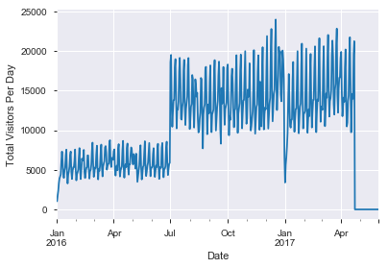
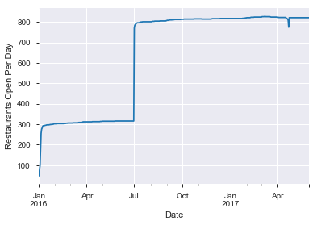
Daily Visitors
There is a large change in total daily visitors.
This corresponds to an increase in the number of restaurants in the data.

Slide 5
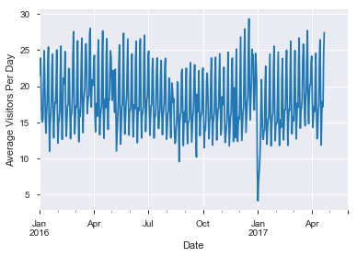
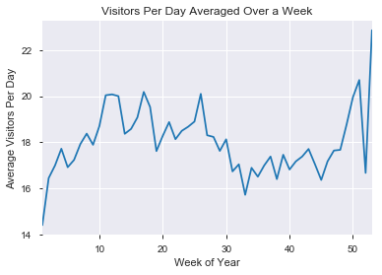
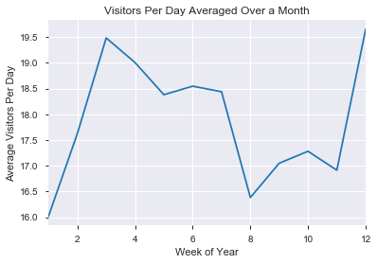
A seasonal variation becomes apparent as a longer timespan is averaged over.

Slide 6
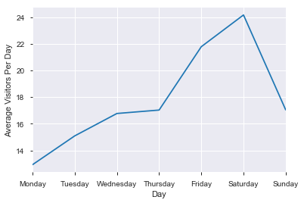
Daily Average
This is the average visitors per restaurant or each day of the week over the whole time-span.
There is a definite weekly variation.
Friday and Saturday have a >40% increase in visitors over the rest of the week.

Slide 7
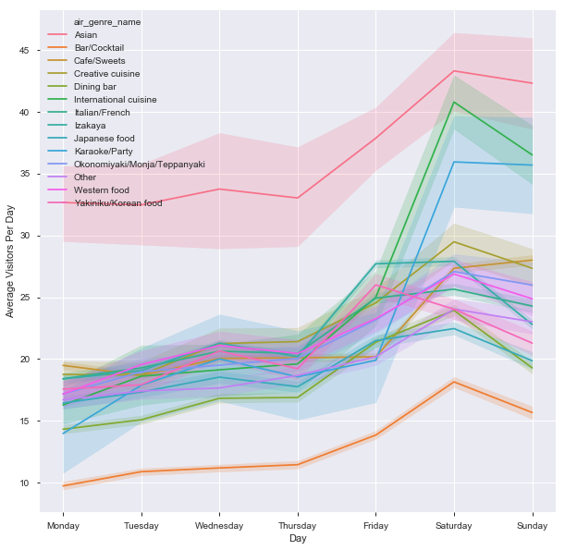
Restaurant Genre
Asian restaurants have more visitors every day of the week.
Bars are below the rest of the genres.
International and Karaoke/Party genres have a larger increase on the weekends than the others.

Slide 8
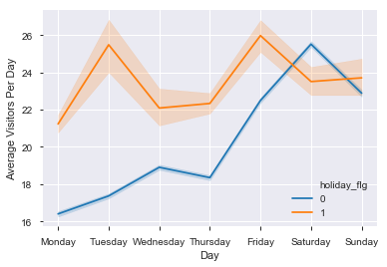
Holiday and Day of Week Interaction
If it is a holiday, the day of the week does not seem to change the number of visitors.
This number is the same as if it were a weekend.

Slide 9
Building Models
I started with a random forest and a gradient boosted machine (GBM).
  With the initial dataset, neither of these performed very well.
  Creating features using rolling statistics for each restaurant greatly improved the performance.
  I then tuned the hyper-parameters for each which showed the GBM to be the best
With the time-series nature of this dataset, I decided to learn more about ARIMA models.
  I chose the parameters for the ARIMA model by examining the data of a random restaurant.
  These models performed better than when the others were trained with no new features, but worse than the best ones.

Slide 10
Conclusions
Creating features can greatly improve the performance of machine learning predictions.
ARIMA models can make decent predictions even though it only uses information on the number of visitors.

